Slide 1
Surface Pattern Recognition Using Shape Subspace
Naish Ibrahim
Supervisor: Kazuhiro Fukui

Slide 2

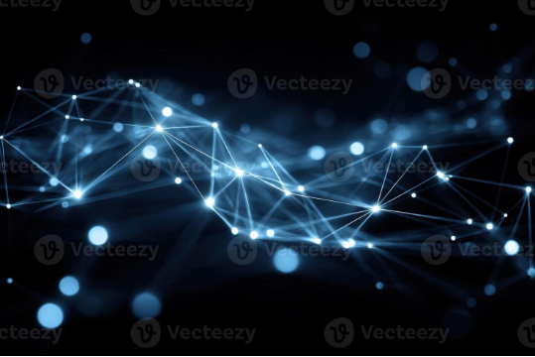
Contents
Research Problem
Research Background
Related Research
Proposed Method
Summary of Initial Research
Limitations Identified
Proposed Method: Sliding Window
Experimental Validation
Future Work

Slide 3
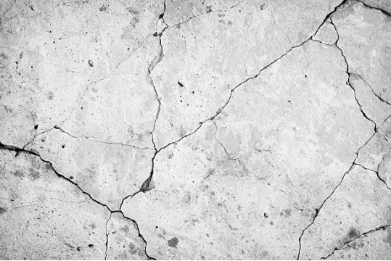
Research Problem
How can Subspace-based methods be used to detect surface irregularities in Point Cloud data?

Slide 4

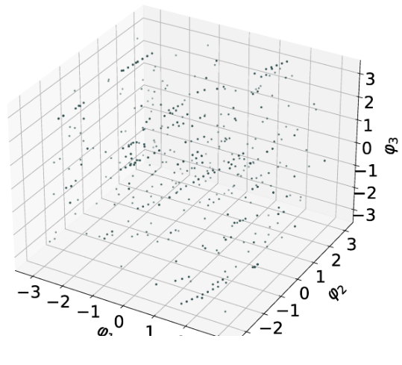
Background: Point Cloud
Point Cloud processing involves handling 3D data represented as a collection of points in space (x, y, z) coordinates.
Data can include coordinates, color (RGB), and normal vectors.

Slide 5

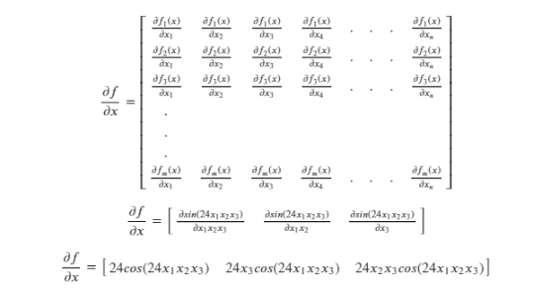
Background: Shape Subspace
A mathematical representation of 3D structures based on the relative positions of feature points.
Used for tasks such as object recognition, motion analysis, and biometric authentication.
Provides an efficient way of representing high-dimensional data.

Slide 6

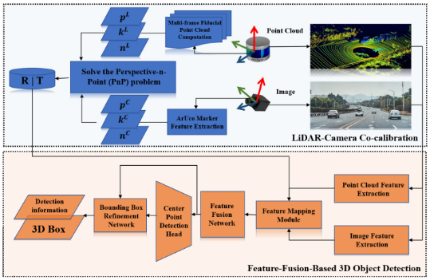
Related Research: Factorization
How is Shape Subspace computed?
One approach is the Factorization Method, which can compute shape subspaces from image sequences and compare them using canonical angles.

Slide 7
Related Research: 3D Features
How is Shape Subspace computed?
Another approach is Direct 3D Feature Extraction, where shape subspaces are generated from 3D feature point sets, such as micro-features on a facial surface.

Slide 8

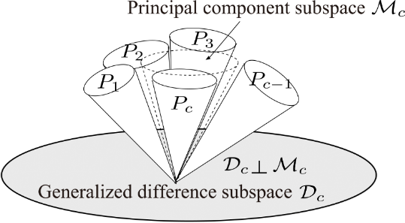
Related Research: Difference Subspace
The Difference Subspace (DS) is a geometric concept that represents the components of difference between two class subspaces.
It extends the idea of a difference vector between two vectors to the case of subspaces.
DS is useful for analyzing and extracting local shape differences, providing a sensitive cue for recognition.

Slide 9






Proposed Method Overview
1. Divide Input
2. Compute Subspace
3. Compare Patches
The input point cloud is divided into a grid of n × n patches.
For each patch, a centered matrix is created and SVD is applied to compute its unique Shape Subspace.
The Difference Subspace (DS) is computed between adjacent patches. A high DS magnitude indicates a local irregularity.

Slide 10

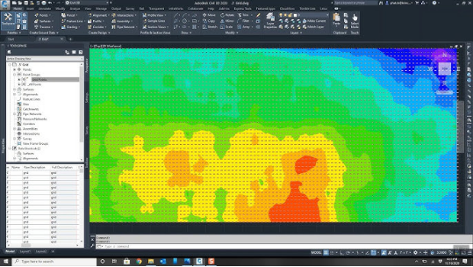
Experiment: Synthetic Floor
Generation of synthetic floor.
Configuration:
Dimensions: 50 × 50 units
Spacing: 1 centimeter apart
Total points: 10,000

Slide 11


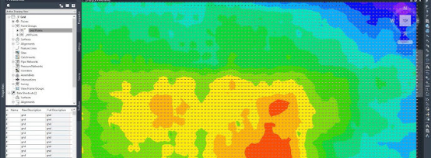
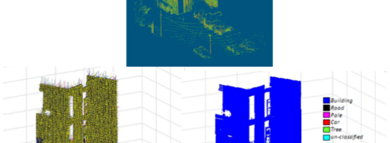

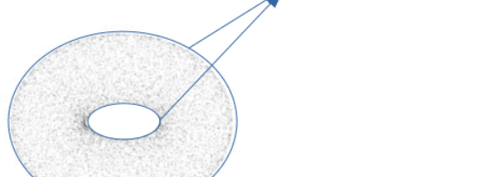

Experiment: Anomaly Patterns

Slide 12
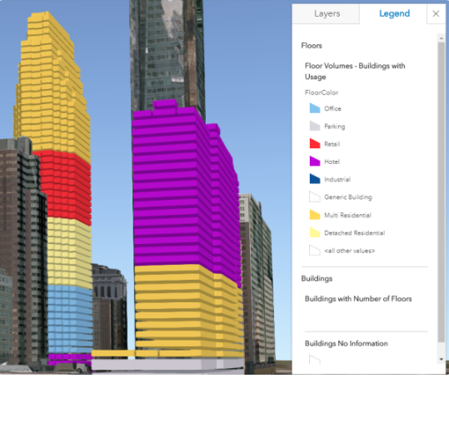
Experiment: Patch Division
Patch division process
The synthetic floor is divided into a grid of patches (e.g., 5x5) for analysis. Each patch is processed independently to compute its shape subspace.

Slide 13

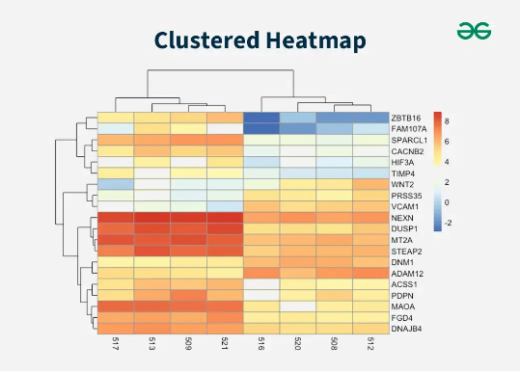
Experiment: DS Generation
DS generation for each patch
The Difference Subspace (DS) magnitude is calculated between a central patch and its neighbors (e.g., 4-neighbor or 8-neighbor approach) to quantify local shape differences.

Slide 14
Summary of Initial Research
Key Results
Pattern Detection: Successfully detected various synthetic patterns (bumps, ridges, corners, circles, etc.).
Accuracy & Stability: Smaller patches (3×3, 4×4) improved fine-detail detection.
Neighborhood: Eight-neighbor comparisons enhanced stability for complex patterns.

Slide 15



Limitations Identified
Boundary Sensitivity
Limited Spatial Resolution
Unvalidated on Real Data
Non-overlapping patches may cut across anomalies, weakening signals near edges and leading to less accurate localization.
Sparse, discrete patches provide a coarse map, making it harder to detect and precisely locate fine-grained anomalies.
The method was only tested on clean, synthetic data. Robustness against real-world noise and irregularities was unproven.

Slide 16

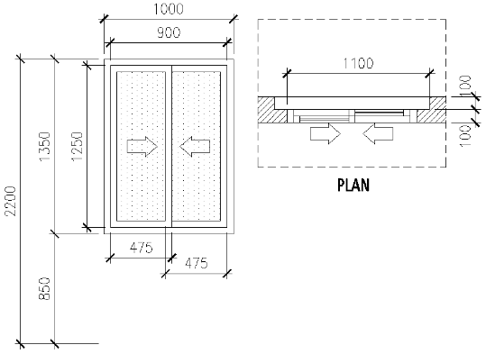
Proposed Method: Sliding Window
Concept
Overlapping Regions: Introduces analysis regions that overlap with configurable percentages (e.g., 50%).
Continuous Coverage: Ensures every point is analyzed multiple times, mitigating boundary sensitivity.
Increased Resolution: Generates more analysis points, achieving finer spatial resolution for anomaly localization.

Slide 17

Sliding Window: Methodology (1)
Given a point cloud with dimensions (W,H), a window size (w,h), and an overlap percentage α.
The stride parameters (sx, sy) — the distance the window moves — are calculated as:

Slide 18

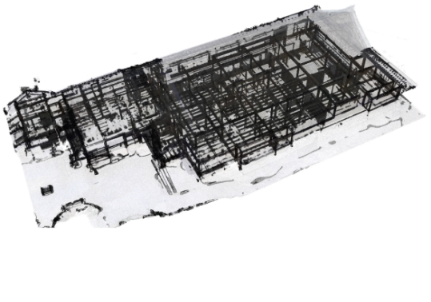
Sliding Window: Methodology (2)
The total number of windows (Nx, Ny) and the region Ri,j for each window are defined:

Slide 19
Experimental Validation: Setup
Comparison Methods
Fixed Patches (Baseline): 8×8 grid (64 patches), used as reference.
Sliding Window (Proposed): 50% overlap, increasing analysis density.
Data Used
Synthetic: 50×50 units, ~10,000 points with predefined patterns.
Real-World: PLY File, 61,914 points from a noisy floor scan.

Slide 20
Experimental Validation: Settings
Common Settings
Subspace Dim: Set to 3 for all computations.
Neighbors: Used 8-neighbor DS calculation for context.
Sliding Overlap: Fixed at 50% for better coverage.
Preprocessing
Centering: Removed translation for geometry-only focus.
Min Point Filter: Ensured enough points per window for stable SVD.

Slide 21
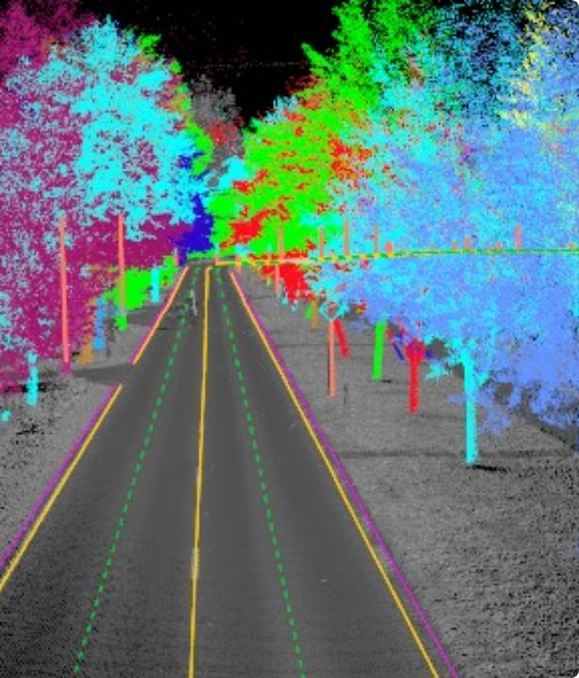
Future Work
Adaptive Parameters
Multi-Scale Analysis
Performance Boost

Slide 22
Questions?
Thank you.

Slide 23
Part 2: Automatic Segmentation of Aircraft Dents
Applying Subspace Concepts to a New Domain

Slide 24

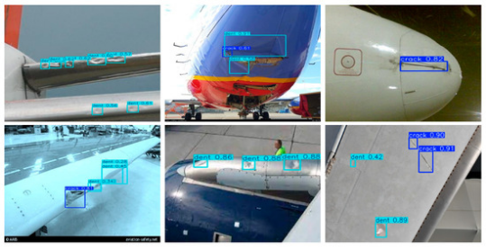
New Problem: Aircraft Dent Inspection
Motivation
Aircraft dent inspection is currently a manual, tedious, and subjective process, prone to human error. Dents are subtle, smooth deformations without clear boundaries.
Challenge
How do we automatically segment these dents from high-resolution 3D point clouds?
Lack of labeled training data is a major hurdle.
Dents have no distinctive features.
Engineers require interpretable and trustworthy results.

Slide 25

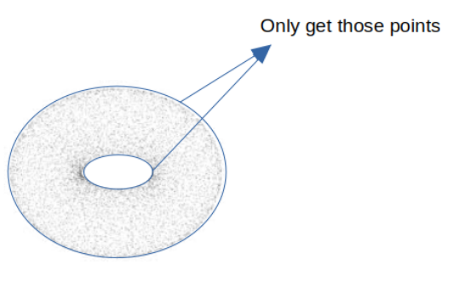
Connecting Previous Work
Recap of Initial Research
We explored Shape Subspace methods on synthetic floors.
Fixed Patch Analysis: Successfully detected known patterns (bumps, ridges).
Sliding Window Extension: Provided 3.5x higher resolution and handled noisy, real-world PLY files more effectively.
Key Finding
Method selection is data-dependent. Sliding window/patch-based methods showed more robustness to noise. This motivated exploring a similar patch-based approach for aircraft dents.

Slide 26
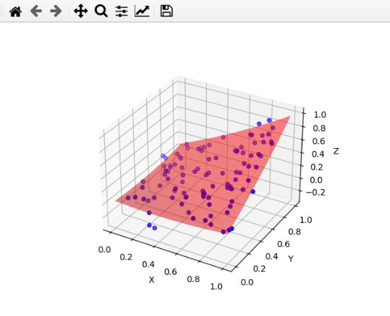
A Solution: DentNet's 2.5D Strategy
Handling 3D Data Efficiently
The DentNet paper introduces an elegant 2.5D strategy:
Quadric Surface Fitting: A bivariate quadratic function, z(x,y), is fit to the 3D point cloud to capture the baseline aircraft curvature.
Residual Calculation: The distance of each point from this fitted surface is calculated. Dents appear as high-residual regions.
This effectively converts the complex 3D data into a 2D residual map, which is fast, memory-efficient, and highlights deformations for a CNN.

Slide 27

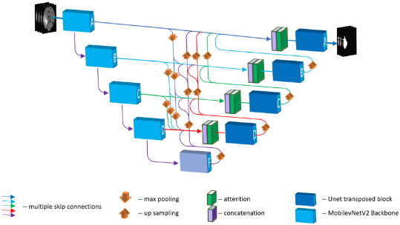
DentNet Architecture (U-Net FCN)
A U-Net for Segmentation
DentNet uses a Fully Convolutional Network based on the U-Net architecture.
Encoder (Downsampling): Extracts features at multiple scales, with a 1024-channel bottleneck.
Decoder (Upsampling): Reconstructs the full-size segmentation mask.
Skip Connections: Propagate fine details from the encoder to the decoder, crucial for precise boundaries.
The model was trained on 30,000 synthetic samples and achieved 99.24% IoU on synthetic validation data.

Slide 28

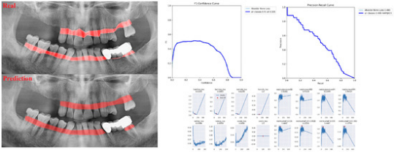
DentNet Synthetic Test Results
Performance on Synthetic Data
On a synthetic test sample, DentNet achieves 98.97% IoU.
The output shows:
Input Residuals: The dent is clearly visible as a blue depression.
Probability Map: Hot colors indicate high confidence of a dent.
Final Prediction: The boundaries are smooth, accurate, and (green) match the ground truth.

Slide 29








Our Approach: Patch-Based Subspace
1. Patch Extraction
2. Feature Extraction
3. Subspace Classification
4. Reconstruction
Use a sliding window (64x64 patches, 50% overlap) to get ~700 patches per image.
Use pre-trained DentNet encoder (Transfer Learning) to get a 1024-D feature vector per patch.
Build "Dent" & "Normal" subspaces (50 PCs each) via PCA. Classify patch by distance to each subspace.
Aggregate overlapping patch predictions (voting) to generate the final segmentation mask.

Slide 30

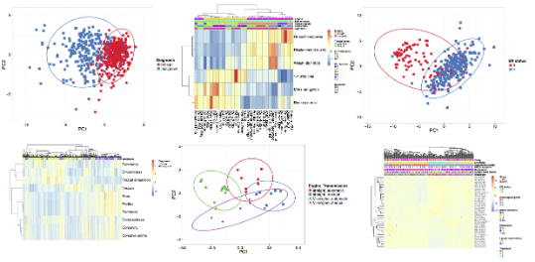
Why Subspace Methods? Interpretability
Beyond the "Black Box"
Unlike a standard neural network, the subspace approach is highly interpretable.
We can visualize the learned patterns.
We can see which features define "dent-ness".
We can quantitatively explain *why* a patch was classified (its distance to the subspaces).
This allows for validation with domain experts.

Slide 31

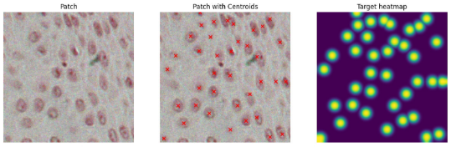
Comparison on Synthetic Sample
DentNet (Original)
98.97% IoU
Very accurate, smooth, circular boundaries.
Very close to ground truth.
Patch-Based Subspace
74.92% IoU
Lower performance, blocky boundaries (due to 64x64 patches).
Slightly overshoots the dent area.
However, the classification is fully interpretable.

Slide 32
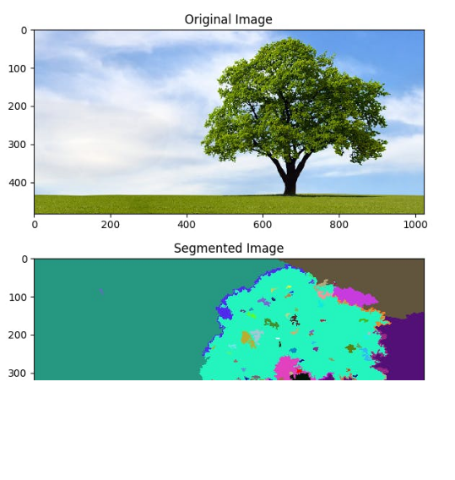
Real-World Challenges
Struggles on Real Data
When tested on real aircraft scans, both methods struggled.
Sample A (0.78mm dent):
DentNet: 41.61% False Positives. Detects scan "strip boundaries" as dents.
Patch-Based: 20.65% False Positives. Better, but still problematic.
Sample C (15mm deep dent):
Both methods show 0% detection.

Slide 33





Analysis: Why Do Both Methods Fail?
Domain Gap
Quadric Fitting Issue
Magnitude Mismatch
Training data (clean, synthetic) lacks real-world scan artifacts like stitching "strip boundaries". The models misinterpret these as anomalies.
Training: Fit *excludes* dent points (uses ground truth). Inference: Fit *includes* all points (no mask), "flattening" the dent and making it invisible.
Training was on 1-3mm dents. Real data was 0.78mm (too shallow) or 15mm (too deep), falling outside the trained range.

Slide 34
Summary & Lessons Learned
Implemented DentNet (99.24% synthetic IoU) and a Patch-Based Subspace approach.
Synthetic: DentNet is highly accurate (98.97%); Patch-based is interpretable but less precise (74.92%).
Real Data: Both methods struggle. The patch-based approach shows slightly better generalization to noise (20.65% FP vs 41.61% FP).
Connection: This confirms our initial finding: patch-based/sliding-window methods can be more robust to noise and domain gaps.
Main Lesson: The domain gap and preprocessing (quadric fitting) are the most significant challenges to solve for real-world deployment.

Slide 35
Future Directions
Robust Quadric Fitting
Augment Training Data
Domain Adaptation

Slide 36
Questions?
Thank you.

Slide 37

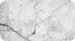
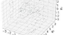
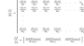
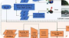
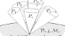
Image Sources
https://static.vecteezy.com/system/resources/previews/070/686/548/non_2x/abstract-plexus-network-connecting-dots-futuristic-technology-data-visualization-science-and-innovation-background-photo.jpeg
Source: www.vecteezy.com
https://media.istockphoto.com/id/537282082/photo/concrete-wall.jpg?s=612x612&w=0&k=20&c=1WvI93m1VSecirbrX4FJ-B1k4fzI844HfqFvBd4XaPM=
Source: www.istockphoto.com
https://www.mdpi.com/mathematics/mathematics-11-04024/article_deploy/html/images/mathematics-11-04024-g006.png
Source: www.mdpi.com
https://miro.medium.com/v2/resize:fit:1200/1*3DsAYUB3W_H8QzPLY3_6iA.png
Source: kaushikmoudgalya.medium.com
https://www.mdpi.com/wevj/wevj-16-00306/article_deploy/html/images/wevj-16-00306-g001.png
Source: www.mdpi.com
https://csdl-images.ieeecomputer.org/trans/tp/2015/11/figures/fukui5-2408358.gif
Source: www.computer.org

Slide 38
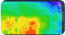
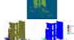
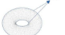
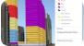
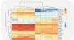
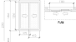
Image Sources
https://i.ytimg.com/vi/HuN70PSgIo4/hq720.jpg?sqp=-oaymwEhCK4FEIIDSFryq4qpAxMIARUAAAAAGAElAADIQj0AgKJD&rs=AOn4CLASEMleBivQ-GAQaxqMHPfUdtQk6w
Source: www.youtube.com
https://pub.mdpi-res.com/remotesensing/remotesensing-05-01624/article_deploy/html/images/remotesensing-05-01624-ag.png?1580948272
Source: www.mdpi.com
https://i.sstatic.net/b7eai.png
Source: stackoverflow.com
https://www.esri.com/arcgis-blog/wp-content/uploads/2018/01/BuildingFloors_SpaceUse_legend.png
Source: www.esri.com
https://media.geeksforgeeks.org/wp-content/uploads/20240612184116/Clustered-Heatmap.webp
Source: www.geeksforgeeks.org
https://assets.cadbull.com/product_img/original/2024/Slidingwindowdetailplanandsection2DCADblockDWGAutoCADdrawingThuJun2024065647.png
Source: cadbull.com

Slide 39
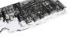
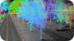
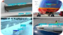
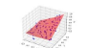
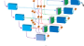
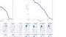
Image Sources
https://pub.mdpi-res.com/remotesensing/remotesensing-16-03750/article_deploy/html/images/remotesensing-16-03750-g001a.png?1728558953
Source: www.mdpi.com
https://geoai.au/wp-content/uploads/2023/11/tree-Extraction.jpg
Source: geoai.au
https://www.mdpi.com/drones/drones-09-00594/article_deploy/html/images/drones-09-00594-g012-550.jpg
Source: www.mdpi.com
https://media.geeksforgeeks.org/wp-content/uploads/20230328110107/Screenshot-from-2023-03-28-11-00-40.png
Source: www.geeksforgeeks.org
https://pub.mdpi-res.com/sensors/sensors-22-06501/article_deploy/html/images/sensors-22-06501-g001.png?1661774626
Source: www.mdpi.com
https://www.mdpi.com/diagnostics/diagnostics-13-01800/article_deploy/html/images/diagnostics-13-01800-g001-550.jpg
Source: www.mdpi.com

Slide 40
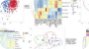
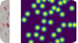
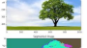
Image Sources
https://biit.cs.ut.ee/clustvis/frontPage/frontPage.png
Source: biit.cs.ut.ee
https://www.mdpi.com/electronics/electronics-14-03705/article_deploy/html/images/electronics-14-03705-g004.png
Source: www.mdpi.com
https://images.prismic.io/encord/acb1201a-e14e-4488-94d7-8ab21680d98b_graph_based_Segmentation.png?auto=compress,format
Source: encord.com

